Slide 1

Exploring
#2 Strings & Numbers

Slide 2
Comment
// komentar 1 line
/*
komentar multiline
komentar multiline
komentar multiline
*/

Slide 3
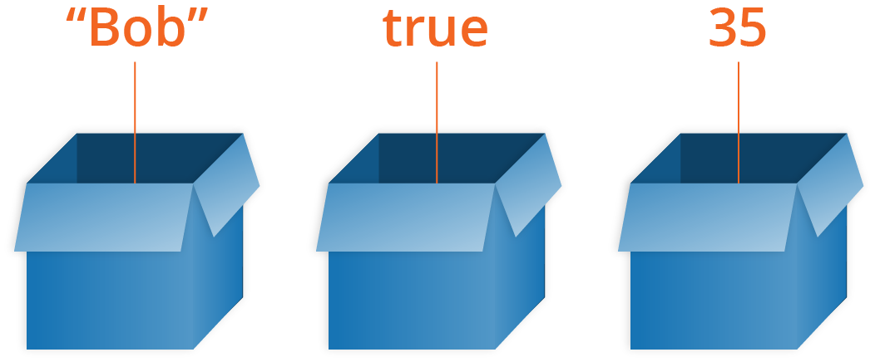
Variable
Variables are named values and can store any type of JavaScript value.

Slide 4
Variable
var nama = 'Andi';
console.log(nama);
var usia = 22;
console.log(usia);
let jomblo = true;
console.log(jomblo);

Slide 5
Naming Variables
Variable names rules:
Start them with a letter, underscore (_), or dollar sign ($).
After the first letter you can use numbers, letters, underscores (_), or dollar sign ($).
Don’t use any JavaScript’s reserved keywords, such as var, let, this, etc.

Slide 6
var vs let
var x = 21
var x = 22
console.log(x);
// output = 22
=========================
let y = 'hai' let y = 'halo' console.log(y);
// SyntaxError

Slide 7
Prompt & Alert
<write on HTML!>
var kabar = prompt('Apa kabar?'); //muncul kotak dialog input
console.log(kabar); //tampilkan input di console
alert(kabar);
//tampilkan input di alert window

Slide 8
Data Type
let nama = 'Andi';
let usia = 22;
let jomblo = true;
let kerja;
console.log(typeof(nama));
console.log(typeof(usia));
console.log(typeof(jomblo));
console.log(typeof(kerja));
console.log(kerja);

Slide 9
Primitive Data Type
String : kumpulan char, text
Number : integer / float
Boolean : logic data type, true/false
Undefined : variabel tanpa value

Slide 10
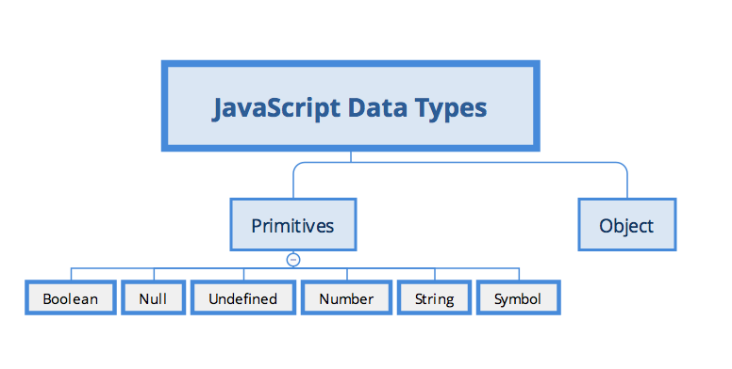
Data Type

Slide 11
Strings
var x = 'Halo Dunia';
console.log(x.length);
console.log(x.indexOf('Dunia'));
console.log(x.substr(5, 3));
console.log(x.slice(5, 8));
console.log(x.split(' ')); //split spasi

Slide 12
Strings
var x = 'halo';
var y = 'DUNIA';
var z = 12345;
console.log(x.toUpperCase());
console.log(y.toLowerCase());
console.log(x.replace('ha', 'mi'))
console.log(x.replace(/ha/g, 'mi'))
console.log(z.toString())
console.log(typeof(z.toString()))

Slide 13
Convert Strings to Numbers
parseInt('123');
parseFloat('123');
parseInt('1234.5678');
parseFloat('1234.5678');
parseInt('Halo Dunia');
parseFloat('Halo Dunia');

Slide 14
Convert Strings to Numbers
let a = parseInt('123');
let b = parseFloat('123');
let c = parseInt('1234.5678');
let d = parseFloat('1234.5678');
let e = parseInt('Halo Dunia');
let f = parseFloat('Halo Dunia');
console.log(a)
console.log(b)
console.log(c)
console.log(d)
console.log(e)
console.log(f)

Slide 15
Convert Strings to Numbers
let a = parseInt('123');
let b = parseFloat('123');
let c = parseInt('1234.5678');
let d = parseFloat('1234.5678');
let e = parseInt('Halo Dunia');
let f = parseFloat('Halo Dunia');
console.log(typeof(a))
console.log(typeof(b))
console.log(typeof(c))
console.log(typeof(d))
console.log(typeof(e))
console.log(typeof(f))

Slide 16
Adding Strings & Numbers
let usia = 22;
let nama = 'Andi';
console.log(usia + usia);
console.log(nama + ' ' + nama);
console.log(nama + usia);
/*
Type Coersion: saat dua variabel
beda tipe digabungkan, akan
diconvert ke String.
*/

Slide 17
Numbers
var a = 3.14;
var b = 3;
var c = 123e5; // 123 x 10⁵
var d = 123e-5; // 123 x 10⁻⁵
var e = 999999999999999; // 15x
var f = 9999999999999999; // 16x
var g = 0.2 + 0.1;
var h = (0.2 * 10 + 0.1 * 10) / 10;

Slide 18
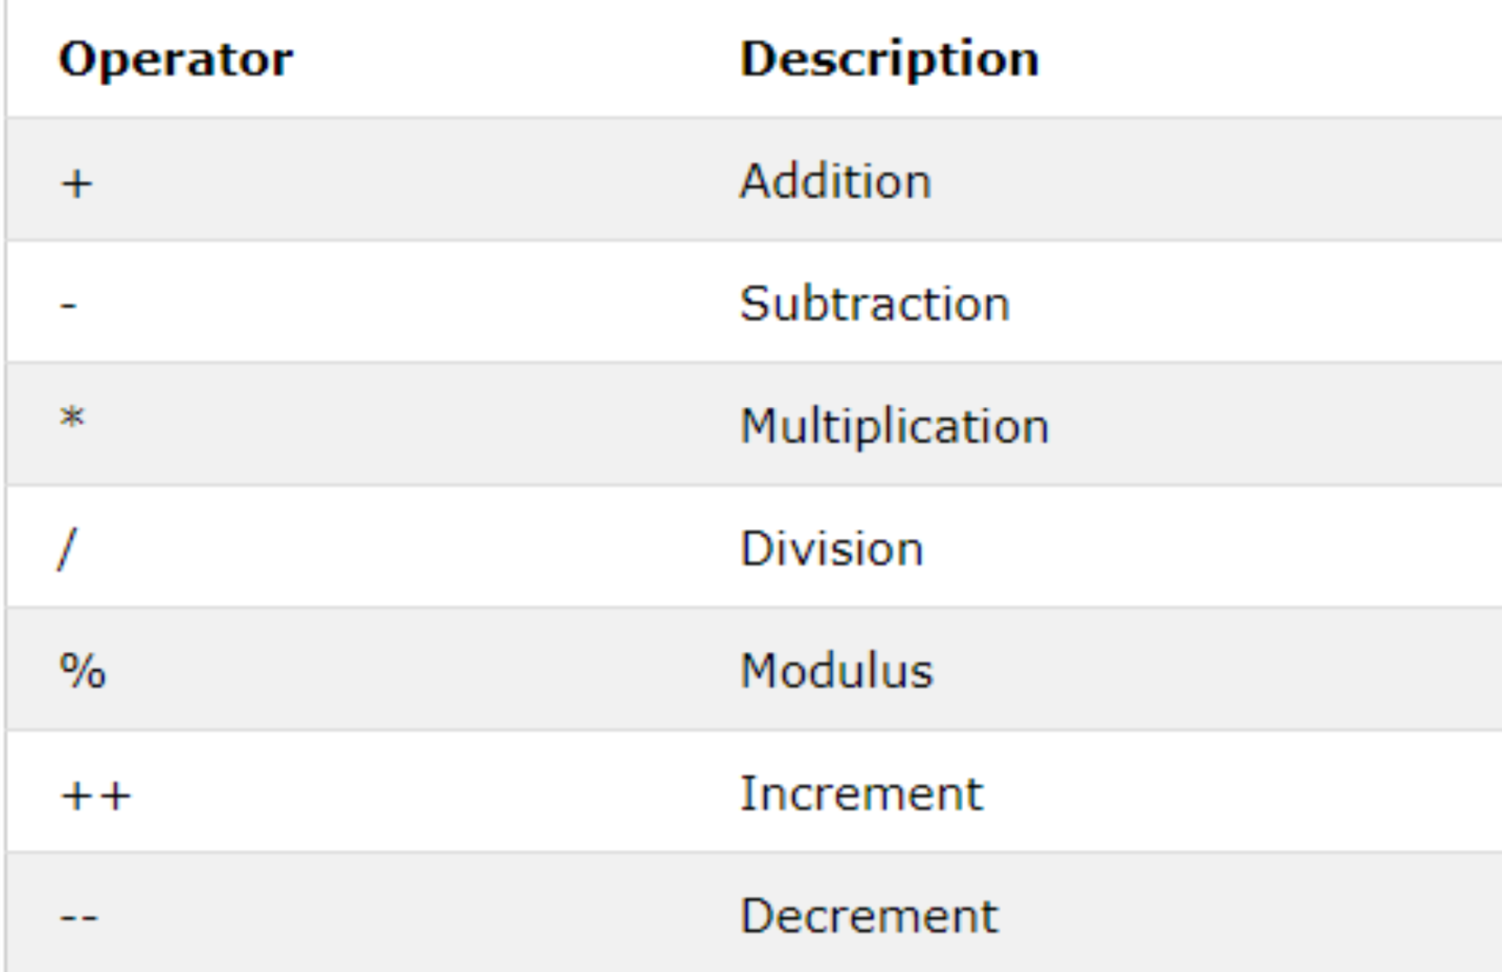
Arithmetic Operators

Slide 19
Arithmetic
Operators
var usiaAndi = 40;
var usiaBudi = 20;
console.log(usiaAndi * usiaBudi);
console.log(usiaAndi / usiaBudi);
console.log(usiaAndi + usiaBudi);
console.log(usiaAndi - usiaBudi);
console.log(usiaAndi % usiaBudi);
console.log(usiaAndi ** usiaBudi);

Slide 20
Arithmetic
Operators
var usiaAndi = 40;
var usiaBudi = 20;
usiaAndi++ // usia Andi +1
usiaAndi++
console.log(usiaAndi);
usiaBudi-- // usia Budi -1
usiaBudi--
console.log(usiaBudi);

Slide 21
Arithmetic
Operators
var usiaAndi = 40;
var usiaBudi = 20;
usiaAndi+=2;
// usiaAndi = usiaAndi+2
usiaBudi*=2;
// usiaBudi = usiaBudi*2
console.log(usiaAndi);
console.log(usiaBudi);

Slide 22
Basic Math Object
console.log(Math.PI);
console.log(Math.abs(-4.7));
console.log(Math.pow(8, 2));
console.log(Math.sqrt(64));
console.log(Math.cbrt(8));

Slide 23
Round, Ceil & Floor
console.log(Math.round(4.7));
console.log(Math.round(4.4));
console.log(Math.floor(4.7));
console.log(Math.ceil(4.4));

Slide 24
Random, Max & Min
console.log(Math.random());
console.log(Math.max(1,3,5));
console.log(Math.min(1,3,5));

Slide 25
Basic Date Object
let a = new Date()
console.log(a.getFullYear())
console.log(a.getMonth())
console.log(a.getDate())
console.log(a.getDay())
console.log(a.getHours())
console.log(a.getMinutes())
console.log(a.getSeconds())
console.log(a.getMilliseconds())

Slide 26
Basic Date Object
getFullYear() Get year (yyyy)
getMonth() Get month (0-11)
getDate() Get day as a number (1-31)
getDay() Get weekday number (0-6)
getHours() Get hour (0-23)
getMinutes() Get minutes (0-59)
getSeconds() Get seconds (0-59)
getMilliseconds() Get milliseconds (0-999)
getTime() Get time (ms since Jan 1, 1970)

Slide 27
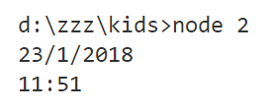
Basic Date Object

Slide 28


Solve It! #1
$$if x=4, y=3 \& z=2$$
$$w={\left(\frac{x+y×z}{x×y}\right)}^{z}= ?$$

Slide 29
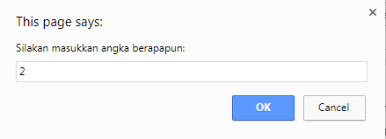
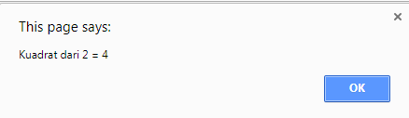
Solve It! #2

Slide 30

Solve It! #3
$$\sqrt[3]{8}= ?$$

Slide 31
Solve It! #4
485 hari.
Nyatakan dalam tahun, bulan, minggu dan hari.
*1 bulan = 30 hari, 1 tahun = 360 hari.

Slide 32
Solve It! #5
Saat ini, jumlah usia Andi & Budi = 49 th, dengan rasio Usia Andi & Budi = 0.4.
Berapa usia Andi & Budi
2 tahun lagi?

Slide 33
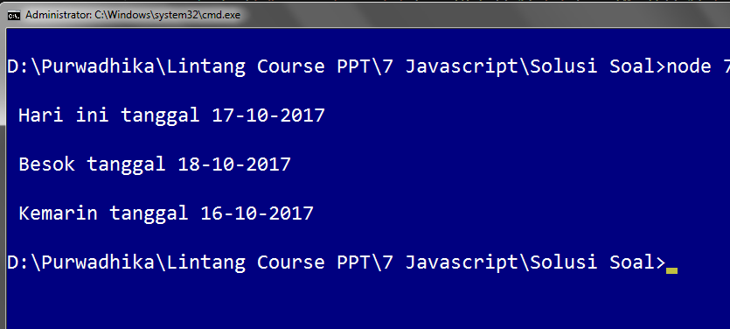
Solve It! #6
lintangwisesa@ymail.com

Slide 34
Solve It! #7
lintangwisesa@ymail.com
Buatlah algoritma untuk menghitung karakter tertentu dalam String!
Misal: “Halo Dunia” memiliki
huruf ‘a’ sebanyak 2 buah.

Slide 35
Solve It! #8
lintangwisesa@ymail.com
Jarak mobil A & B = 120 km.
A berjalan 60km/h dari timur.
B berjalan 40km/h dari barat.
A & B start pukul 9 WIB.
Jam brp A & B bertabrakan?

Slide 36
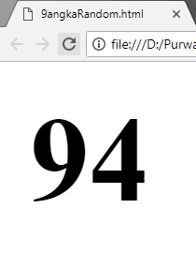
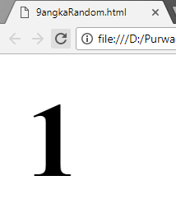
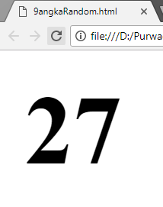
Solve It! #9
lintangwisesa@ymail.com
Tampilkan bilangan acak
(antara 1-100) di Browser

Slide 37
Exploring
#2 Strings & Numbers

